Slide 1
Final Project 1: Lightning Pitch
Raymond Delacruz

Slide 2
Media affects cryptocurrency prices
Problem
Cryptocurrency, similar to stock is unpredictable. Does negative or positive news affects it’s price?
Data
Bitcoin
Ethereum
Online Media
Hypothesis
Positive news affects the price of cryptocurrency in an upward trend.

Slide 3
Problem
A cryptocurrency is a digital or virtual currency that uses cryptography for security. The two most popular types of cryptocurrency are bitcoin and ethereum. With the rise in hacks, price volatility, and current stances in the political landscape cryptocurrency is as relevant as ever. In terms of how they are traded, their market values are $45B and $18.5B respectively. Similar to stock, the price changes have been unpredictable. As an active trader, I have noticed that there have been specific media stories that have drive the prices both up and down. Does negative or positive news affects it’s price?

Slide 4
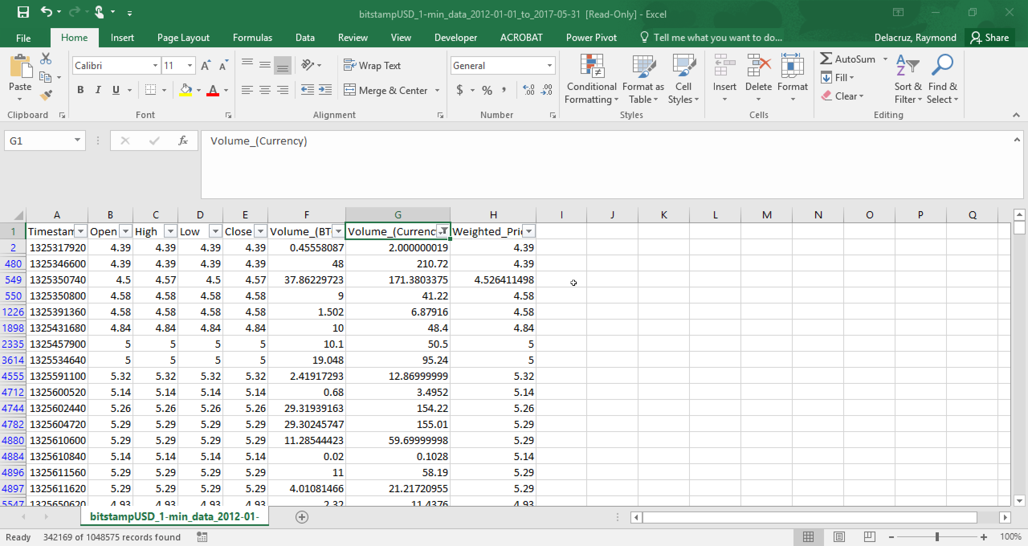
Data

Slide 5
Hypothesis
Positive news affects the price of cryptocurrency in an upward trend.
By running a regression on both percent change and whole dollar amount, then we will be able to predict if the price will trend upwards or downwards.

Slide 6
Pokemon Go decision tree
Problem
Pokemon Go can seem random, but is their a correlation that relates to where pokemon appear?
Data
Kaggle
Hypothesis
It is possible to predict where pokemon will appear based on historical data.

Slide 7
Problem
PokemonGo is a mobile augmented reality game. It is available on multiple platforms including: iOS, Android, and Apple Watch devices. In the game, players use a mobile device's GPS capability to locate, capture, battle, and train virtual creatures, called Pokémon.
In order for a user to encounter these pokemon, there are different methods in luring or locating them. There are also multiple online sources that provide near-time data on where a pokemon is currently located. Instead of relying on these methods, if we could predict where they appear it would make playing the game less effort intensive.

Slide 8
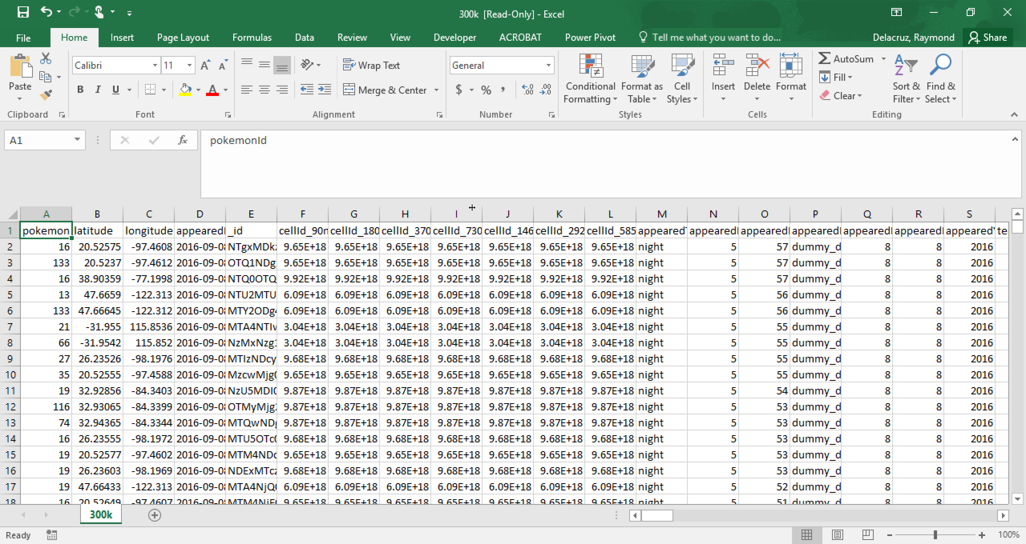
Data

Slide 9
Hypothesis
It is possible to predict where pokemon will appear based on historical data.

Slide 10
Ticketing Optimal Sell Thru Rate
Problem
Price elasticity in ticket prices fluctuate and there is no concrete answer on how to maximize sales.
Data
StubHub
Hypothesis
The different genres will have specific optimal sell-thru rates.

Slide 11
Problem
The correlation between Sell-Thru Rate and price is direct. The higher the sell-thru rate the lower the average ticket price. Whereas, the lower the sell-thru rate the higher the average ticket price.
There is currently no standard solution on optimal sell-thru rate to maximize sales at a genre level.

Slide 12
Data
StubHub

Slide 13
Hypothesis
The optimal sell-thru rate will be between 60 – 80% and will vary based on genre.

